Slide 1
ALA Euclid
Community Update
November 20, 2024

Slide 2
Purpose of Today’s Meeting
Review current Euclid campus conditions
Review bond scope of work
Receive your feedback to help formulate recommendation to superintendent and board

Slide 3
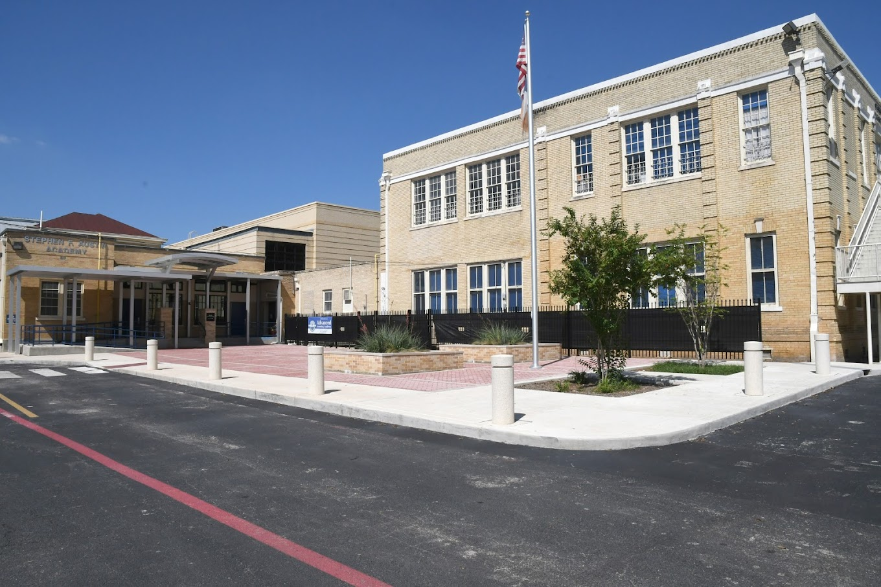
Possibility of New ALA Building
In negotiations with Mission and partners to fund a new school that would allow consolidation of ALA campus
Requesting a new building for the campus at a yet-to-be-determined location
We are looking at district-owned properties within 5 miles of this location
Notes:
Key points:
For years there has been a desire to have a single campus for all ALA grades.
The small footprint of this campus does not make that possible - there isn’t enough room to add on to the building and still have space to support your curricular needs.
We had been exploring options for a new campus on the 2.3-acre Camaron property and you may have seen on the news last week that we are in negotiations with the Mission and their partners for a new school for ALA.
We have not yet determined the location but we are looking at properties SAISD already owns, within five miles of this campus.

Slide 4
Element 2
Fund new construction of a building for the Advanced Learning Academy (ALA)
Proposal | Comments | Background
SAISD to construct a new Pre-K-5 ALA (at a site to be determined) using TIRZ funds. Projected cost of $45 million. | Missions expressed general interest in supporting SAISD's academic programming. This solution solves a current challenge of an oversubscribed school and avoids use of eminent domain power to acquire needed land. | Proposed baseball stadium interferes with plans for an ALA expansion at Kingsbury St. and Flores St. that has been in planning since 2021. ALA at Euclid cannot currently accommodate grades 4 and 5.
Notes:
<Patti will review bullet points.>
It is important to remind you and to highlight for the community that the District has been monitoring the growth of our three very successful programs that currently occupy the Fox Tech campus, and we have been considering and taking action on expansion, specifically for the Advanced Learning Academy.

Slide 5
Initial Proposal to Sell
2016-2018
SAISD conducted a sealed bid process for the sale of various surplus properties in efforts to consolidate and raise funds for a new central office.
Among the properties under the sealed bid process were Fox Tech baseball field and the Fox Tech football field.
SAISD approved a bid to sell the aforementioned fields to Weston Urban. A contract to sell and convey the fields was being reviewed/revised in summer and fall of 2016.
SAISD withdraws the sale as a result of the success and growth of the Cast Tech program, which SAISD anticipated would require additional land to support future growth.
Notes:
<Patti will review bullet points.>

Slide 6
Initial Proposal to Acquire
2021-2022
SAISD conducted a sealed bid process in late 2021/early 2022 to sell/exchange the Fox Tech baseball field.
Weston Urban submitted a bid to exchange its nearby land for SAISD’s Fox Tech baseball field.
Issues in the negotiation related to soil remediation of Weston Urban’s land and indemnity (among other issues) resulted in a withdrawal from the negotiation by Weston Urban.
Notes:
<Patti will review bullet points.>

Slide 7
Initial Proposal to Acquire
2021-2022
The purpose of the proposed acquisition was to build a new Pre-K-5 elementary.
The new elementary would allow the Advanced Learning Academy (ALA) to consolidate Pre-K through 3 grades (currently on Euclid Avenue) and 4 - 5 grades (currently on the Fox Tech campus) into one building.
The proposed site would have been the property adjacent to the Quincy building.
Notes:
<Patti will review bullet points.>

Slide 8
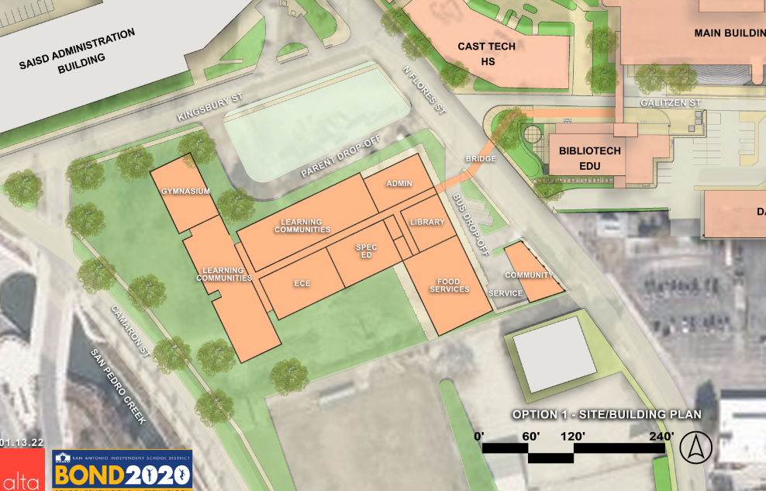
Initial Proposal to Acquire
2021-2022
Notes:
<Patti will orient the Board and community to the location of the proposed school.>

Slide 9
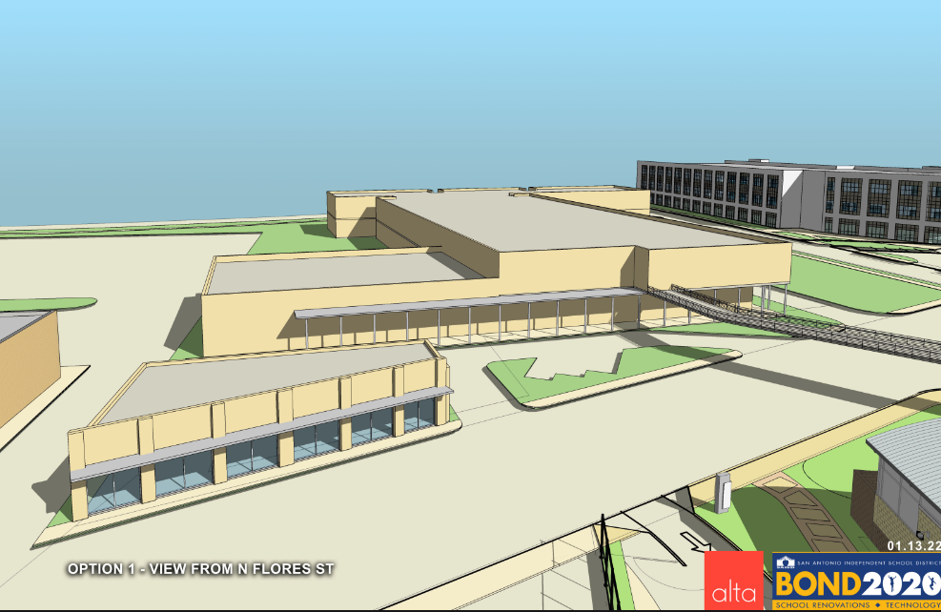
Initial Proposal to Acquire
2021-2022
Notes:
<Patti will orient the Board and community to the location of the proposed school.>

Slide 10
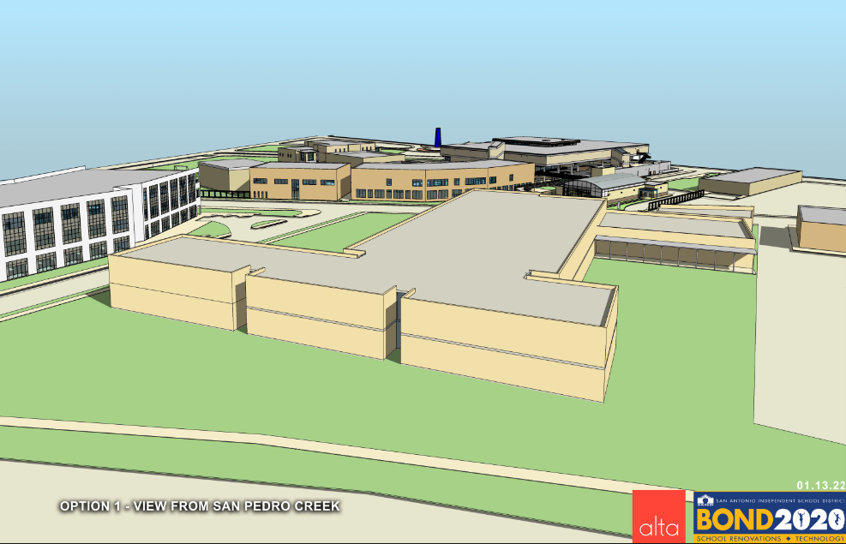
Initial Proposal to Acquire
2021-2022
Notes:
<Patti will orient the Board and community to the location of the proposed school.>

Slide 11
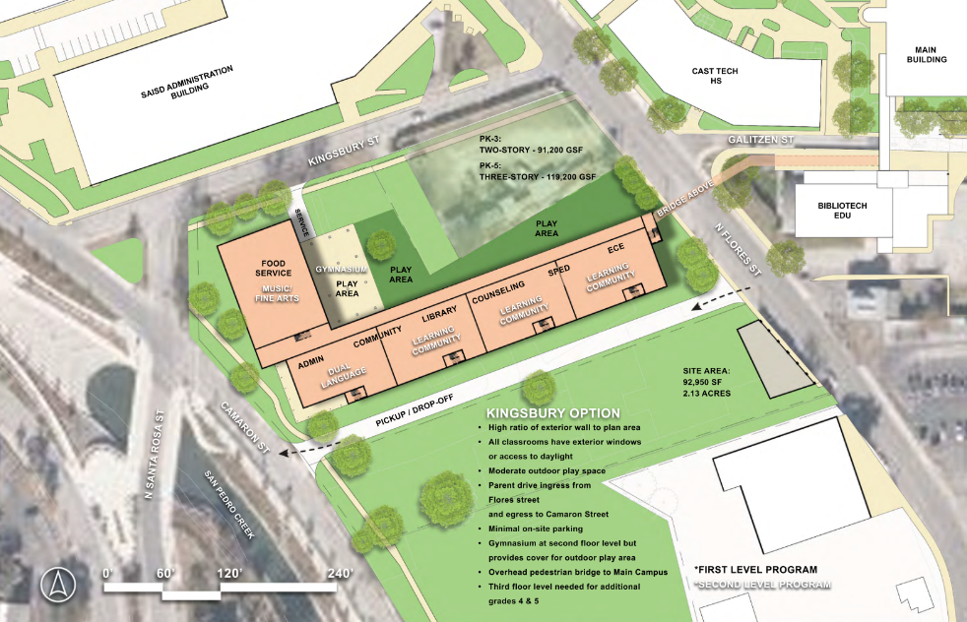
Initial Proposal to Acquire
2021-2022
Notes:
<Patti will orient the Board and community to the location of the proposed school.>

Slide 12
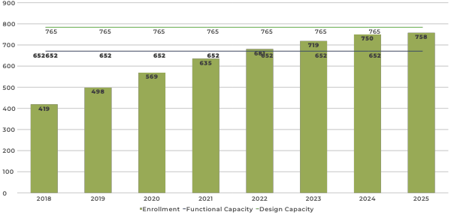
ALA (Fox Tech) Historical Enrollment
Design Capacity
Functional Capacity
Data Source: 2012 to 2023 - TAPR; 2024 - PEIMS submission; 2025 - PEIMS October snapshot
Notes:
<Patti will orient the Board and community to the historical enrollment and distinguish between design and functional capacity..>

Slide 13
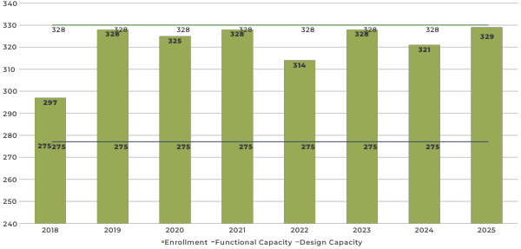
ALA (Euclid) Historical Enrollment
Design Capacity
Functional Capacity
Data Source: 2012 to 2023 - TAPR; 2024 - PEIMS submission; 2025 - PEIMS October snapshot
Notes:
<Patti will orient the Board and community to the historical enrollment and distinguish between design and functional capacity..>

Slide 14
Waitlist at ALA
Advanced Learning Academy Total |  | 725
ALA at Euclid
Advanced Learning Academy | PK4 | 1
Advanced Learning Academy | K | 71
Advanced Learning Academy | 1 | 57
Advanced Learning Academy | 2 | 55
Advanced Learning Academy | 3 | 62
ALA at Fox Tech
Advanced Learning Academy | 4 | 101
Advanced Learning Academy | 5 | 84
Advanced Learning Academy | 6 | 126
Advanced Learning Academy | 7 | 89
Advanced Learning Academy | 8 | 60
Advanced Learning Academy | 9 | 4
Advanced Learning Academy | 10 | 2
Advanced Learning Academy | 11 | 10
Advanced Learning Academy | 12 | 3
Notes:
There are currently 725 students on the waitlist to attend ALA.

Slide 15
Bond 2020 - ALA Euclid
2024
Over the past two months, the Division of Operations, including Construction & Capital Planning, has met with CAST and the ALA Euclid principal regarding ongoing building and construction challenges.
The ALA Euclid building, formerly Austin Elementary, is over 130 years old.
The age and condition of the building have presented significant challenges and we commissioned a Facilities Conditions Assessment (FCA) for a better assessment of the building.
The condition of the building likely means that the 19 million bond will be spent primarily on infrastructure, and the remaining needs must be addressed in a future bonds.
Notes:
<Patti will review bullet points.>

Slide 16
Bond 2020 - ALA Euclid
2024
A more significant challenge is that the ALA Euclid building may not be able to accomodate the existing Pre-K-3 graders with the addition of 4th and 5th grades as previously planned.
Accommodating 4th and 5th grades might impact the educational adequacy of the building.
Notes:
<Patti will review bullet points.>

Slide 17
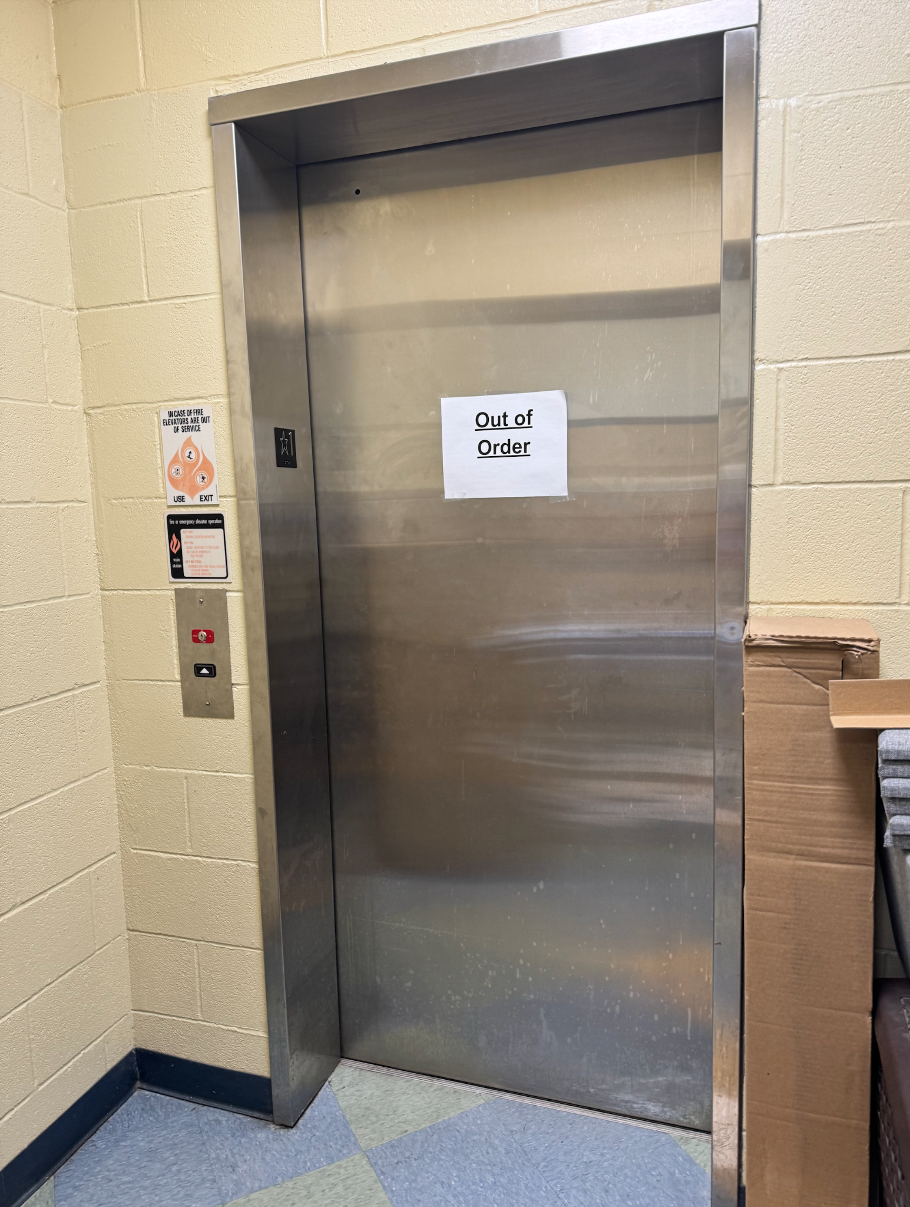
Current State Facility
Building dates back to 1878; last renovated in 2005
Old infrastructure presenting challenges. Examples include:
Leak under the building will require costly foundation work
Leak contributing to smells in the building
Elevator parts no longer manufactured; elevator must be replaced
Roof, windows, HVAC need to be replaced
Building design and site footprint do not align well with program needs
Notes:
Key points:
The reason why we are having this conversation is that the current building is very old - it dates back to the late 1870s.
There are a number of major infrastructure challenges, including a leak under the building that will require costly foundation work and that has been contributing to smells in the building.
The elevator is so old that replacement parts are no longer made, so we have to replace the elevator, which we had hoped to repair.
And, as I already mentioned, the small footprint makes it difficult to expand to meet the long-term needs of the school, especially with its strong outdoor education component.

Slide 18
Facility Condition Assessment
A Facility Condition Assessment is a systematic and structured process used to evaluate the condition, performance, and overall health of a building or facility's physical components and systems.
A Facility Condition Index (FCI) is a numerical value that measures the condition of a facility by comparing the cost of repairs to the cost of replacing the facility
50.2
Notes:
Key points:
There’s actually a numerical value that tells us the condition of your building, and that we use to inform our decisions about facilities. It’s called the Facility Condition Index, or FCI.
Each campus is assigned what’s called a facility condition index or an FCI for short. It’s a numerical value that tells you quickly what condition your school is in.
ALA’s FCI is XX.
To get the FCI, we conducted a facility condition assessment for our district, which is an in-depth way of evaluating the condition, performance and overall health of a building.

Slide 19
Interpreting the FCI
Key point: The lower the FCI, the better a facility’s condition.
Facility overhaul recommended at 60% or higher.
Source: Facility Executive, Aug. 16, 2023: Understanding Facility Condition Index
Notes:
Key points:
To put that into perspective, the best facilities have an FCI of less than 10%. The worst of greater than 60%.
Generally, you want to start replacing a facility with an FCI of 60% or higher.
Thus tonight’s conversation.

Slide 20
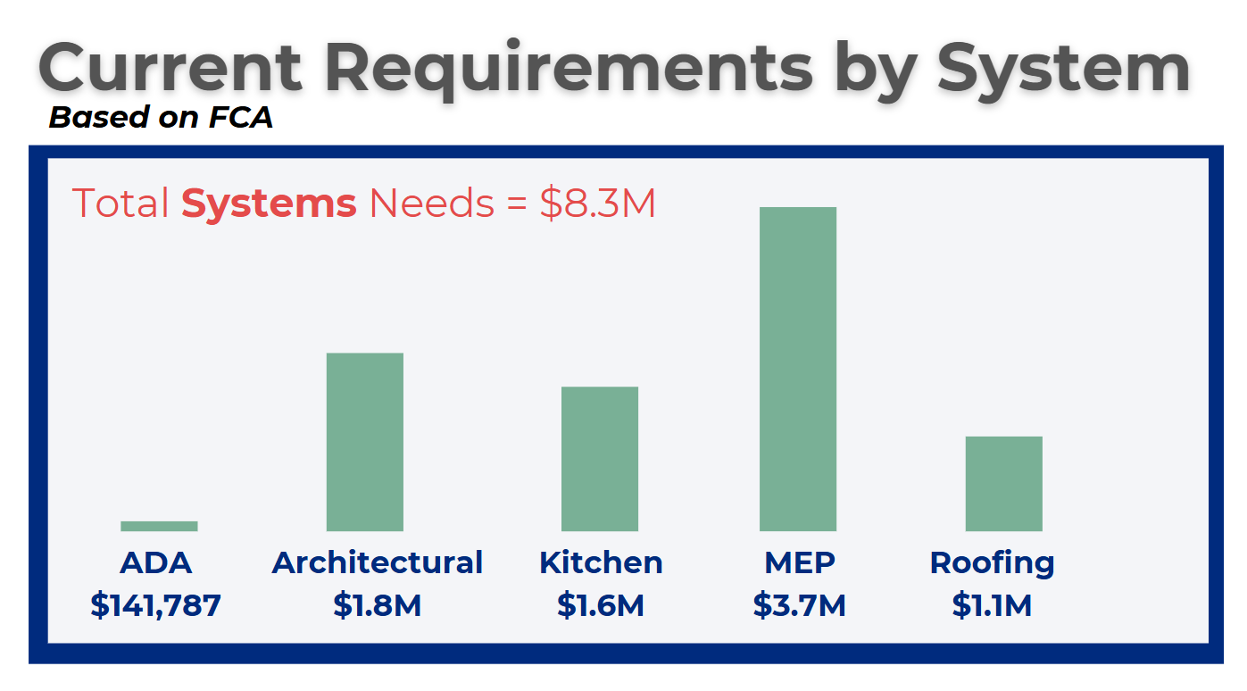
Systems Needs
Notes:
Key points:
Before I move on, though, I want to share that we responded to campus concerns about the smell in the building by conducting multiple tests, including mold and soil.
Test results came back and indicated no indoor air quality issues and no additional cleaning or sampling recommended at this time.

Slide 21
Campus Evaluation
Campus asked us to evaluate persistent smells in the building
Conducted testing in multiple areas, including mold and soil
Currently no indoor air quality issues exist; no additional cleaning or sampling is recommended at this time
Notes:
Key points:
Before I move on, though, I want to share that we responded to campus concerns about the smell in the building by conducting multiple tests, including mold and soil.
Test results came back and indicated no indoor air quality issues and no additional cleaning or sampling recommended at this time.

Slide 22
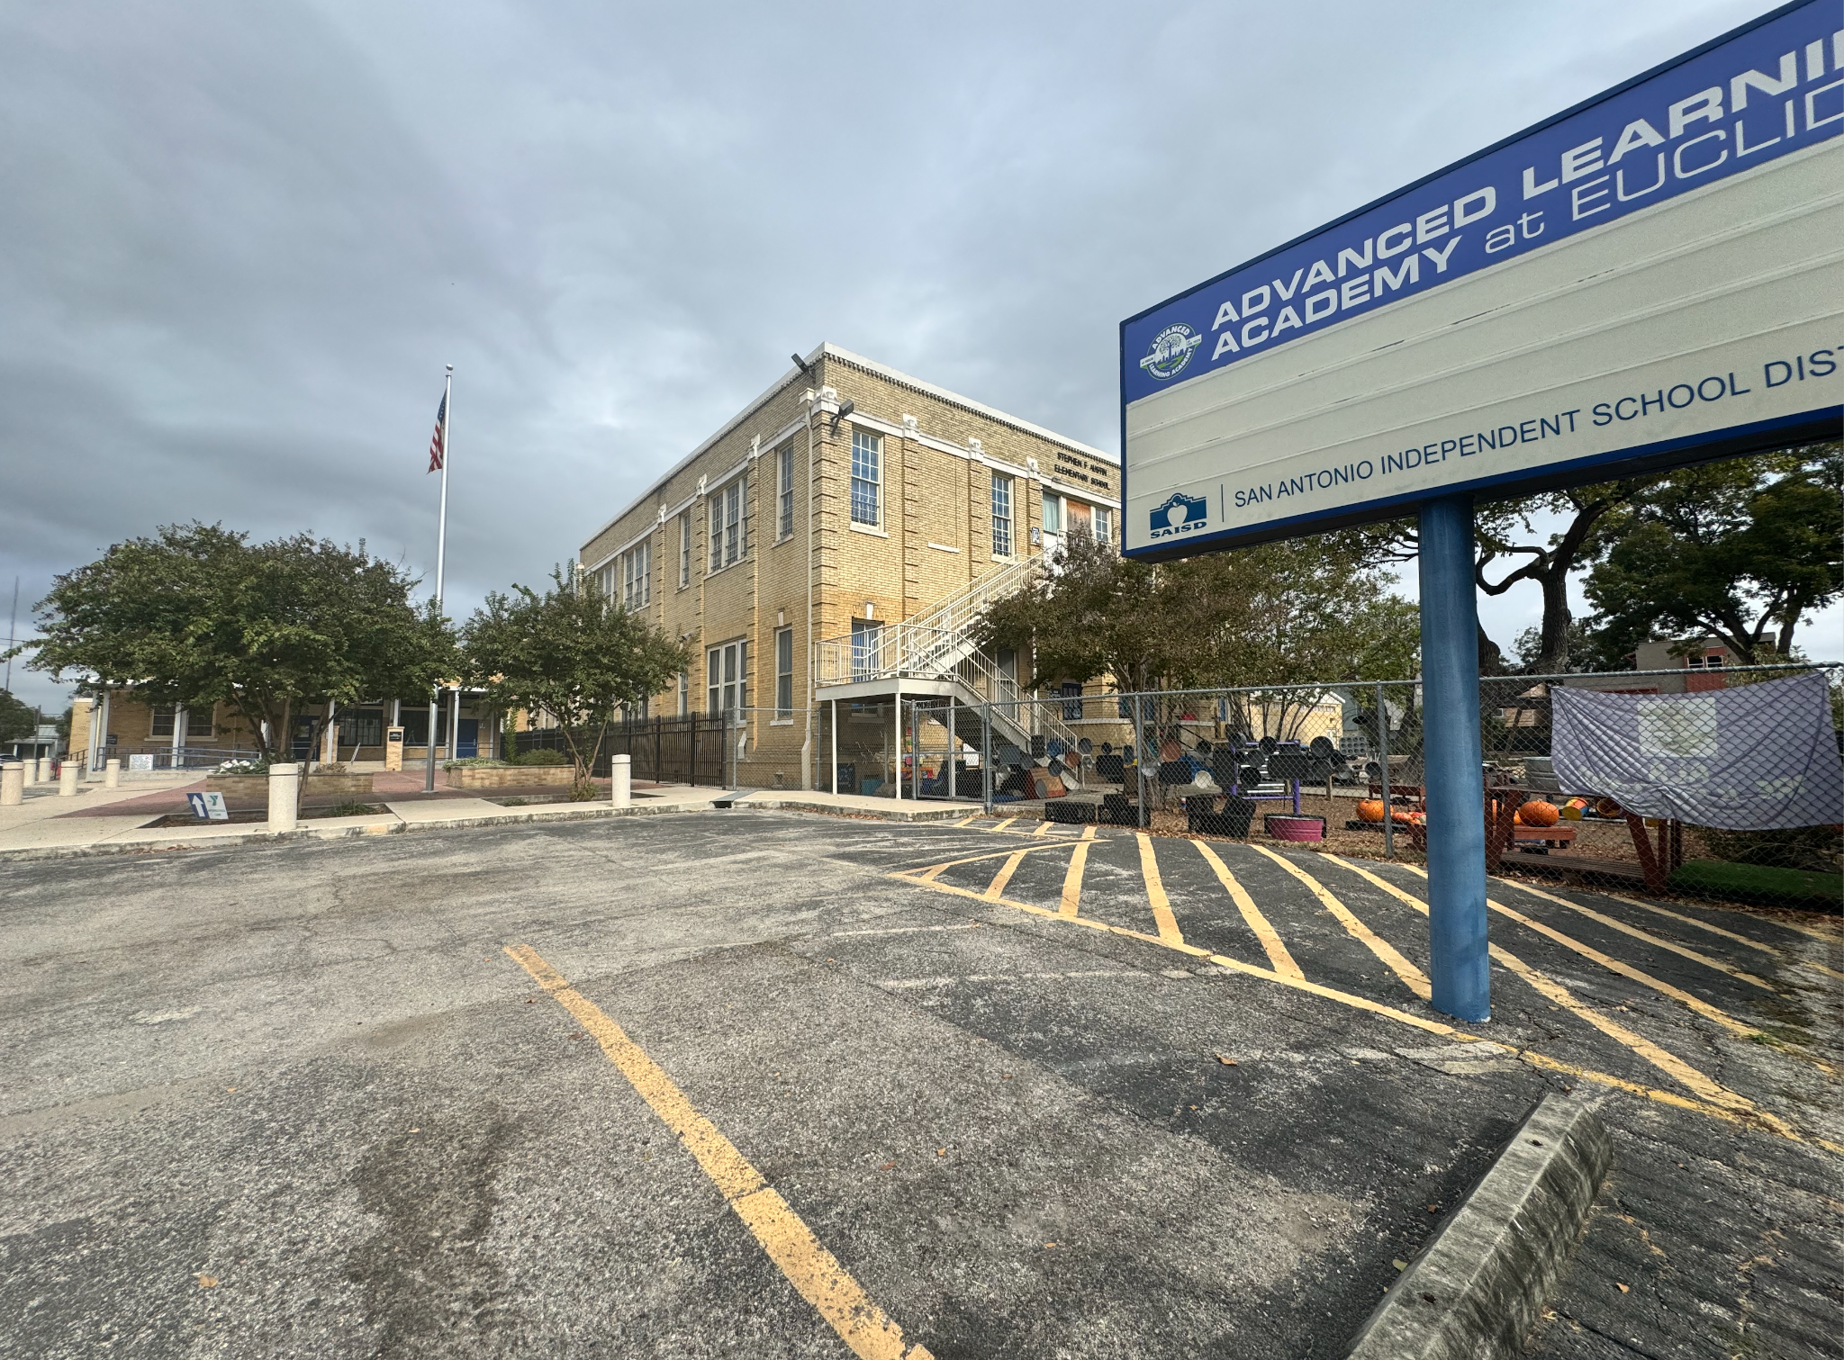
Current Bond 2020 Project Scope & Budget
Total Budget*: $29.5 million
Scope:
Overhaul historic original buildings
Overhaul or replace all classrooms and science labs
Overhaul or replace main office and main entrance to include secured vestibule
Overhaul or replace student dining and kitchen
Replace old exterior windows with new energy efficient windows
Update mechanical systems to the latest energy efficiency and indoor air quality standards
Add new outdoor learning opportunities or replace existing ones
Re-pave and re-surface parking lots and driveways
Add, replace and/or repair existing playground equipment
*Includes architectural, engineering, surveys, permits, construction costs and FF&E
Notes:
Key points:
Here is the current scope of planned bond renovations and the allocated amount.
But based on the infrastructure issues that have developed since this scope was planned, we would need to divert bond dollars to address those issues before we can take care of some of the other renovations
What we want to explore with you today is could we get more out of your school’s bond dollars by investing all or a portion of them at a different location that better meets your program needs?
Can we use the bond dollars to provide state-of-the-art educational environments rather than sinking the funding into correcting aged facilities?

Slide 23
ALA-Euclid Project Budget
Notes:
Key points:
Here is the current scope of planned bond renovations and the allocated amount.
But based on the infrastructure issues that have developed since this scope was planned, we would need to divert bond dollars to address those issues before we can take care of some of the other renovations
What we want to explore with you today is could we get more out of your school’s bond dollars by investing all or a portion of them at a different location that better meets your program needs?
Can we use the bond dollars to provide state-of-the-art educational environments rather than sinking the funding into correcting aged facilities?

Slide 24
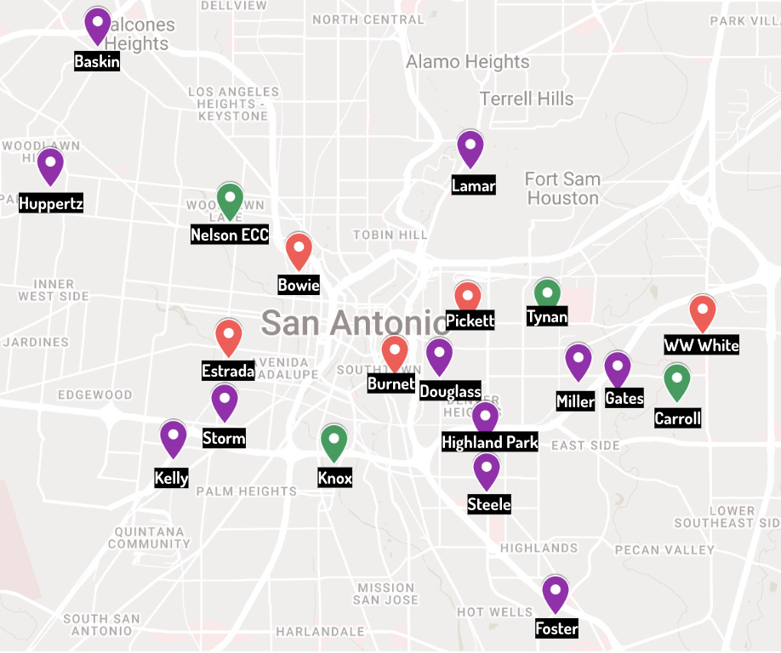
Facilities Available for Repurposing
The decision to Rightsize means that we have facilities available for repurposing. Here’s a current list of the facilities available for repurposing including previously available facilities / properties:
Baskin*
Bowie
Burnet
Carroll*
Douglass
Estrada
Foster
Gates
Highland Park
Huppertz
Kelly*
Knox
Lamar
Miller
Nelson
Pickett
Steele
Storm
Tynan
WW White
*delayed closure
23-24 Campuses
Prior 23-24 Properties
Early Childhood Centers
Notes:
Key points:
While the building is safe to be in, our data tells us it is time to start looking at retiring it and that means finding a new home for ALA – one that better fits your needs.
Negotiations for a brand-new facility aside, we want to get a sense from you on a new location.
As you know, we just completed a round of Rightsizing at the end of last year, which means we have campuses we can consider for relocation.
From this list, there are several we considered for a potential ALA relocation

Slide 25
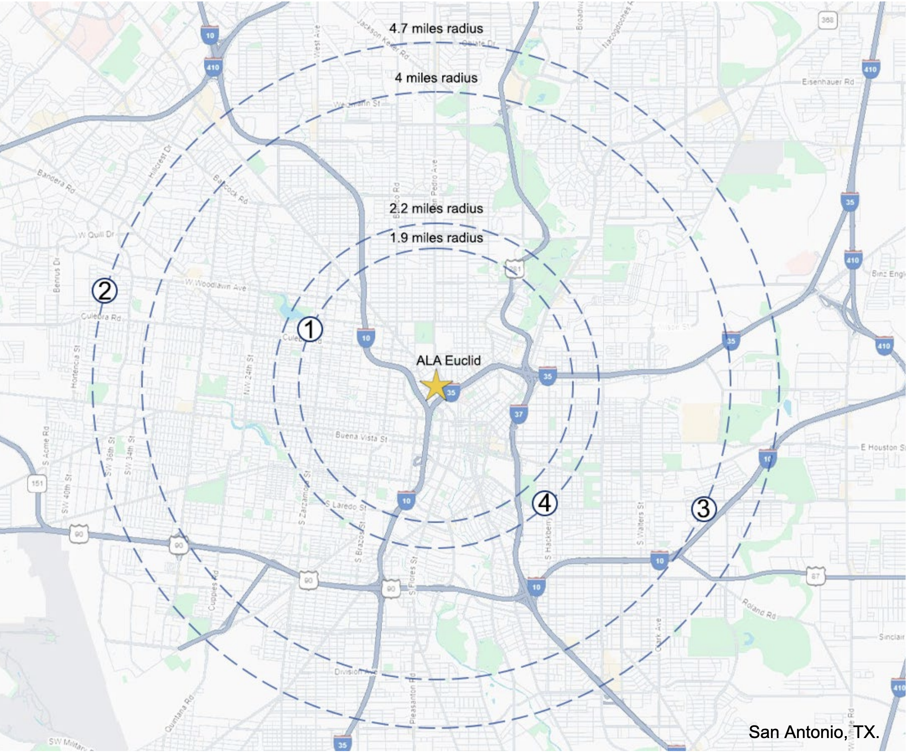
Preliminary Feasibility Assessment
Engaged Alta Architects to conduct a preliminary feasibility assessment
Conducted site visits at four campuses that are within a 5-mile radius of ALA-Euclid
The assessment takes into account Pre-K-3 but all sites would be able to accommodate addition of grades 4 and 5.
Notes:
Key points:
We engaged Alta Architects to perform a preliminary feasibility assessment of the former sites of Nelson Early Childhood Center, Huppertz Elementary, Miller Elementary and Douglass Elementary.
These locations were within a reasonable distance – 5 miles – from the current campus and we thought their facilities might have potential as a new site for ALA.
The preliminary recommendations take into account moving grades Pre-K-3 to a new location, with room at the campus to accommodate the addition of 4th and 5th grades.

Slide 26
Your Input
What do you think?
What should we consider
in developing a recommendation to the superintendent and board?
Notes:
Key points:
So, here’s what we want to know today:
The preliminary feasibility assessment identifies the former Nelson facility as the best option to meet ALA’s program needs.
As a parent, what are your thoughts about this?
And, what should we consider as we develop a recommendation to share with the superintendent and the board?
I’ll open it up now for feedback.

